Slide 1
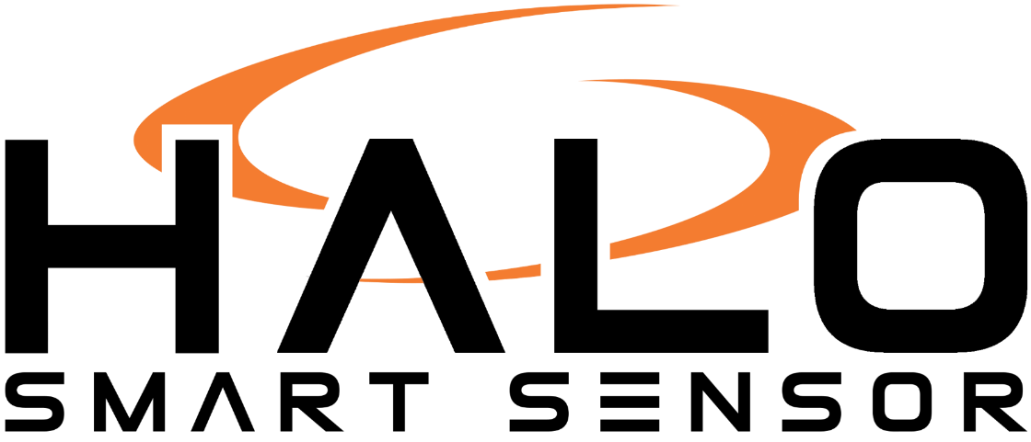
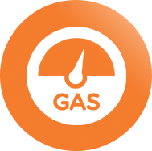

Slide 2
Who is ACP CreativIT?
ACP CreativIT - headquartered in Buffalo Grove – Founded 1984
In July 2017, was purchased by The Zaf Group
The Zaf Group is a family office that invests in Family Owned Businesses
ACP acquired Camera Corner Connecting Point (CCCP) in October 2018
CCCP was founded in 1954 in Green Bay, Wisconsin and focuses on providing best in class IT, AV & Security solutions
ACP/CCCP has continuously delivered solutions for over 100 years
Our Approach:
Customer Obsessed
Personal, Responsive and Flexible
Focused on Business Transformation
Customer Champion-Vendor Neutral
Entrepreneurial Based

Slide 3
Who Is IPVideo?
Since our founding in 1996, our US based operation and R&D facilities have manufactured and distributed network-based, video-centric products, providing customers with solutions at the cutting edge of development.
IPVideo Corporation harnesses the power of PoE and the Internet of Things (IoT) to deliver a range of open platform physical security—sensor and audio/visual solutions that provide maximum flexibility, performance, ease-of-use and value.
We are pioneers in delivering purely network-based audio and video solutions; having entered the market shortly after the invention of the first IP surveillance camera, developing one of the industry’s first network video recording platforms and developing HALO as a camera-less camera that could be put in privacy areas that would not violate privacy laws.
Today, our systems and solutions are used around the world by a diverse cross-section of end users, spanning numerous industries such as Education, Public Safety, Healthcare and Commercial Business, including Fortune 500 companies, government entities and private market leaders.

Slide 4
VAPING CHALLENGES
Dec. 2018
Surgeon General Jerome Adams declares youth vaping an epidemic
Sept. 2019
Michigan and Massachusetts ban flavored e-cigarettes
Nov. 2019
Over 2,000 cases of vaping related illnesses have been reported from 49 states
Sept. 2019
School districts begin to file lawsuits against Juul
Sept. 2019
FDA announces it is conducting a criminal probe into the outbreak of vape-related illnesses and deaths.
Aug. 2019
The first vape related death is reported in Illinois
Oct. 2019
39 vaping related deaths have been confirmed, CDC lists contaminated Vitamin E in THC as the likely source

Slide 5
Product Feature | HALO | Flysense
Security Product | YES | NO
Detects THC | YES | NO
Locally Stored Data | YES | NO
Mandatory Annual Cloud Fees | NO | YES
Certified Product: UL, CE, ULC, ROHS, FCC, WEEE, Plenum Rated, Vandal IK10. | YES | NO
Multiple chemical Sensors and Patent for Unique Signature Detection | YES | NO
Direct Integration into Security Systems | YES | NO
Distinguishes between chemicals | YES | NO
Security Industry Validated | YES | NO
Integrated with Milestone, Exacq, Video Insight, Maxxess, Open Options, and others. | YES | NO
Over 150 independent Measurements | YES | NO
Cyber-Security Protection | YES | NO
Environmental Sensor Product | YES | NO
Winner of Security Product of year along with 12 other Security and IOT industry awards. | YES | NO
“Confidential and Proprietary. © IPVideo Corporation. All Rights Reserved.”

Slide 6
ACP CreativIT Experience With HALO
Engaged since product launch in Jan 2019
600+ deployed
120+ districts

Slide 7
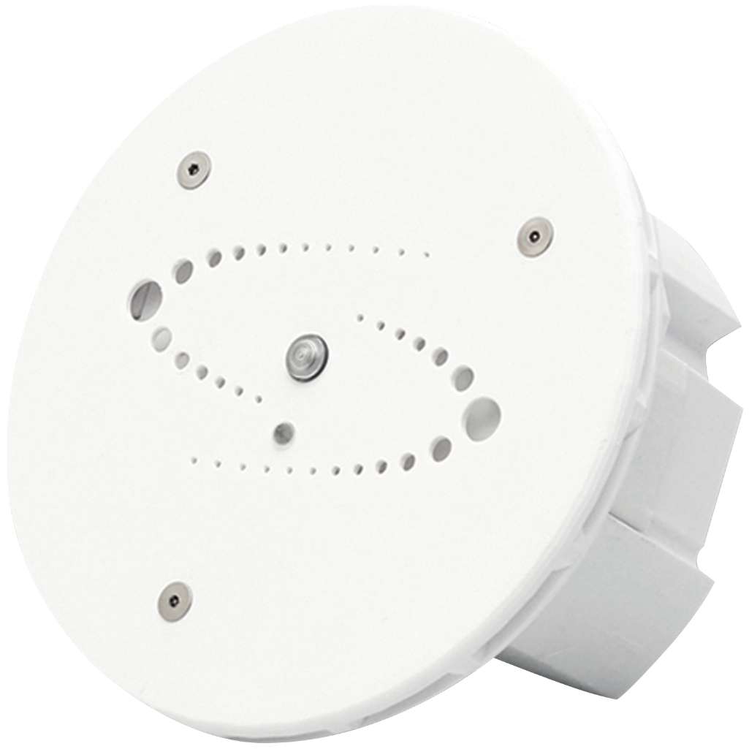
HALO SMART SENSOR
VAPE DETECTION
SOUND DETECTION
AIR QUALITY MONITORING
CHEMICAL DETECTION
HALO uses multiple sensors together in a single intelligent platform to learn, analyze and create event alerts. It has the unique ability to provide instant IoT sensing to event-based triggers and provide security in privacy concern areas where traditional security cameras and solutions are not practical.
Air quality sensors measure things like vape, vape with THC, carbon monoxide, carbon dioxide, chemicals such as ammonia and oxidizers as well as gas leaks. HALO has advanced audio analytics to detect abnormal noise levels. Light detection sensors are utilized for room occupancy. These are coupled with built in temperature and humidity sensors.
www.ipvideocorp.com

Slide 8
MULTI-SENSORS
AUDIO ANALYTICS
AIR QUALITY
CHEMICAL
LIGHT
ENVIRONMENTAL
Abnormal Noise Level Detection
Vape
THC
Formaldehyde
Benzene
Particulates
Volatile Organic Compounds (VOCs)
Ammonia
Carbon Monoxide
Carbon Dioxide
Nitrogen
Occupancy
Sensitivity
Temperature
Humidity
Tamper
Pressure
www.ipvideocorp.com

Slide 9
HALO SMART SENSOR
A real-time vape detector and security device!
Multiple Sensors
HALO has 12 unique sensors that work in conjunction to detect a multitude of measurements with unlimited customization. It’s the only vape detector that detects THC oil!
Designed for Air Flow
HALO was built with air flow in mind! The unit’s design allows the sensors to pick up harmful chemicals faster! The unit cannot be blocked by chewing gum as seen with competitive products.
Less False Alarms
With multiple sensors and advanced analytics, settings are adjusted and maximized for the room’s environment, removing false alarms that singular sensors get from body and disinfectant sprays.
No Cloud Fees
HALO is a security product, not a web app so you won’t have any annual cloud fees!
Integrated Device
HALO connects directly to your security monitor and VMS – no need for separate applications!
Federal & State Grants
IPVideo Corporation will provide support for your grant and aid applications.
www.ipvideocorp.com

Slide 10
INSTALLATION Best Practices
COVERAGE
ORIENTATION
SPACING
AIR FLOW
CEILING MATERIAL / THICKNESS
1 HALO can typically cover 144 square feet with normal ceiling heights (8ft) for vape sensors, however other sensors work effectively up to 1000 square feet.
*Coverage will vary by the ventilation in the room.
HALO should be mounted on a ceiling for best performance.
It is estimated that a 12’ diameter from a HALO will provide vape detection.
Avoid placement near HVAC exhaust, fans and near the door between two rooms. HALO should be in an area relatively free of air currents.
Ceiling material between 0.06”(3mm) and 0.75”(19mm) in thickness will require a surface mounting adapter.
www.ipvideocorp.com

Slide 11
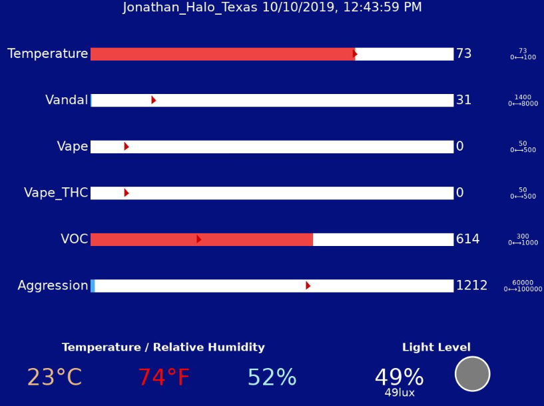
HOW IT WORKS
Sensors
We use multiple sensors within HALO to identify signatures of environmental conditions and exclude false positives. Signatures can include things like vaping and vaping with THC.
Alerts
HALO can send out notifications in multiple ways. This is done either through connections to your own email server for notifications via email and text or integration to a third-party product such as a surveillance, access control or building management system.
Thresholds
Thresholds are levels that can be set to identify an environmental condition present in the atmosphere. Sensitivity of these levels and be adjusted for your environment and needs.
www.ipvideocorp.com

Slide 12
Live Demonstration

Slide 13
Costs
$975 per device 1-30
$75 surface mount adapter (cement or over 9ft)
$275 1hr Training & Config (optional)
Cost to get network line run

Slide 14
Q & A
jgrass@arlingtoncp.com
224-900-8175
Thank You!

